Slide 1
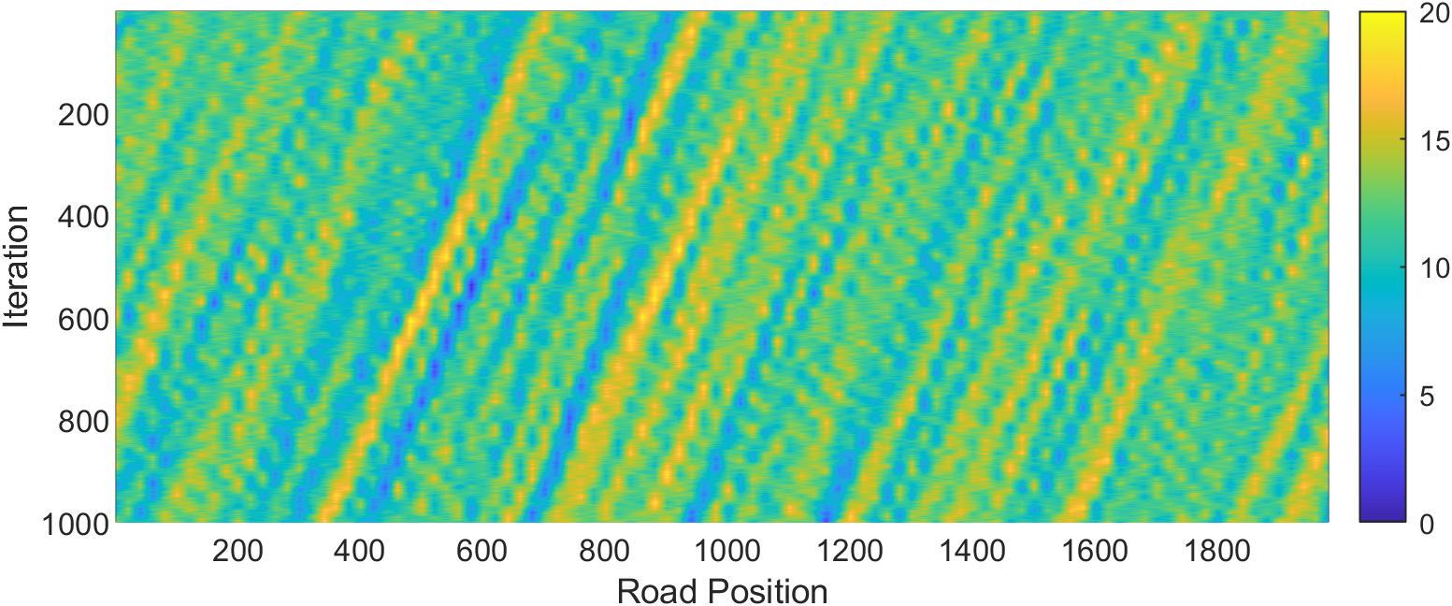
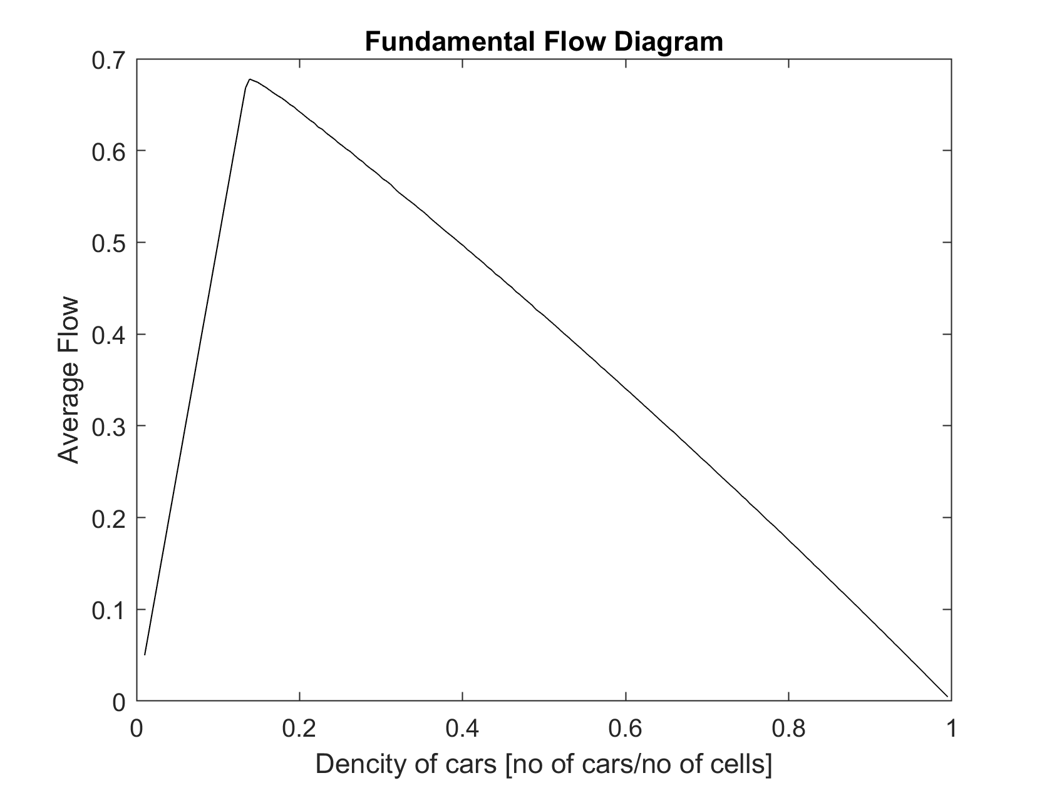
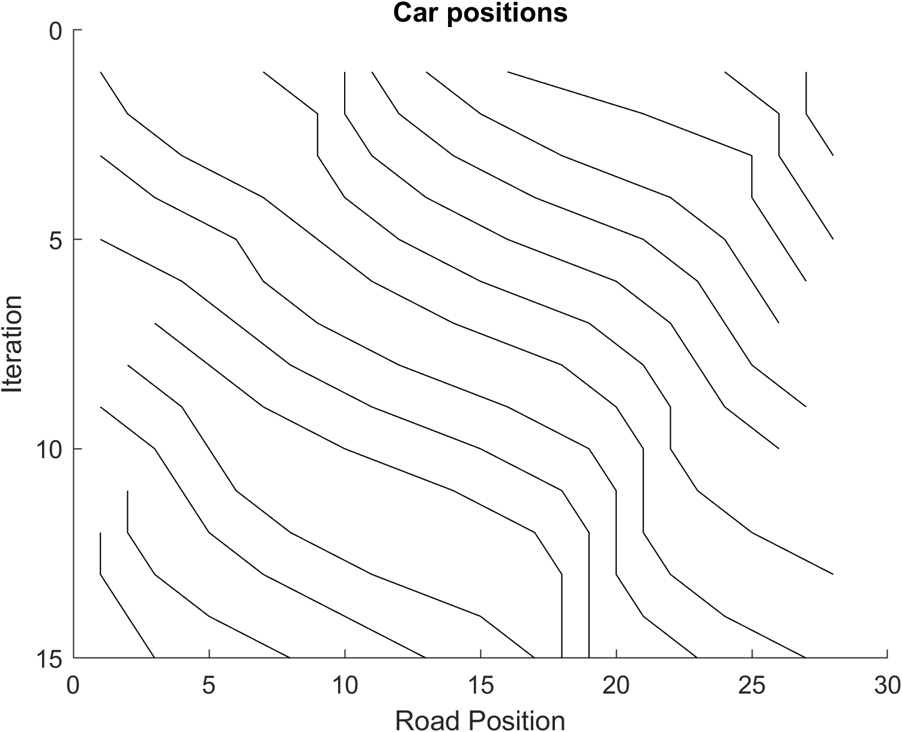
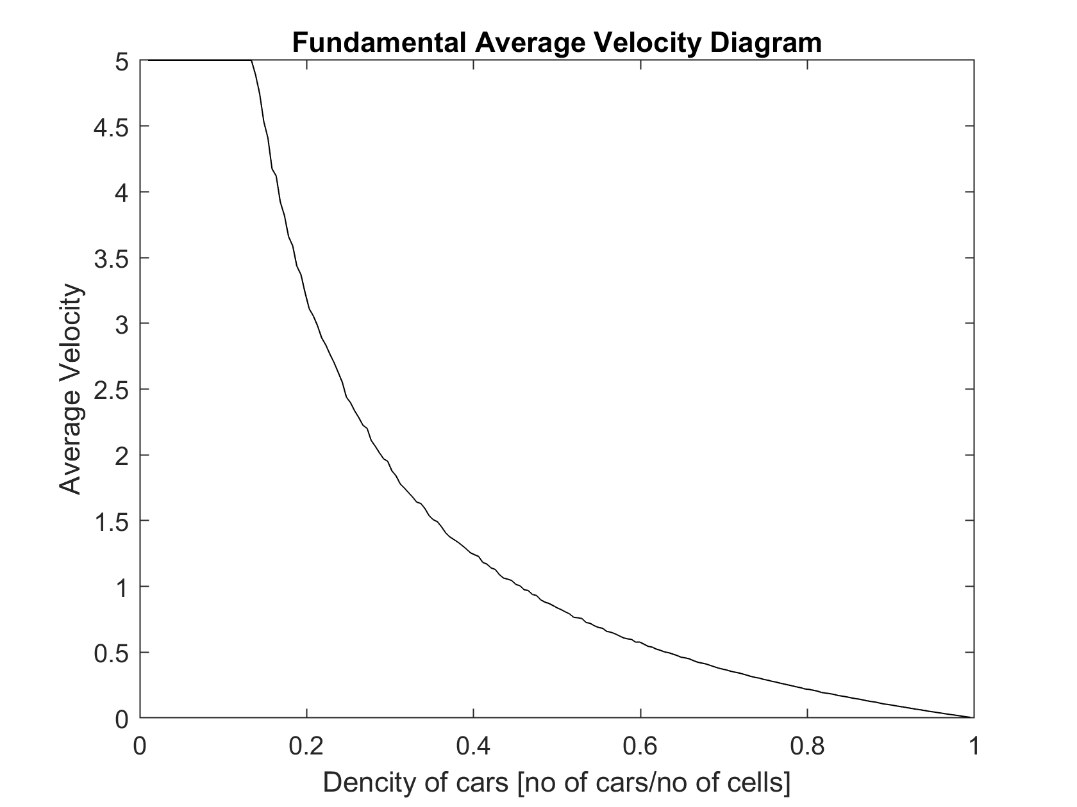
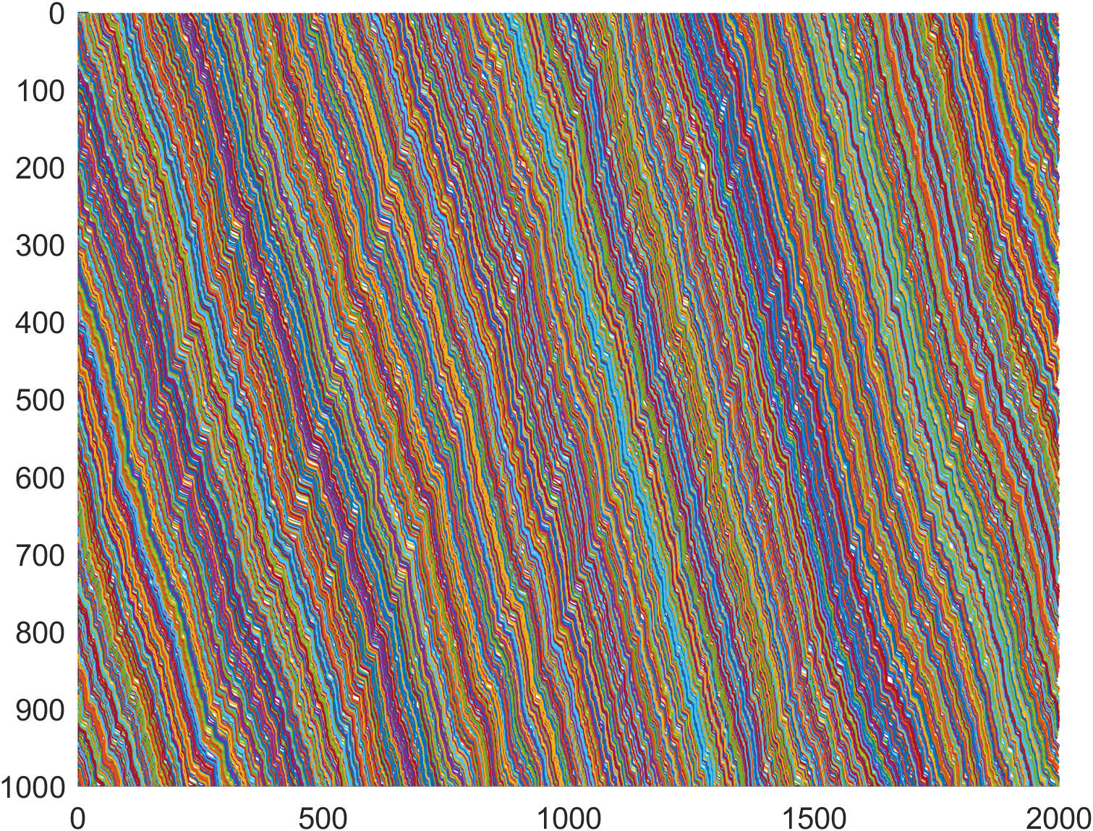
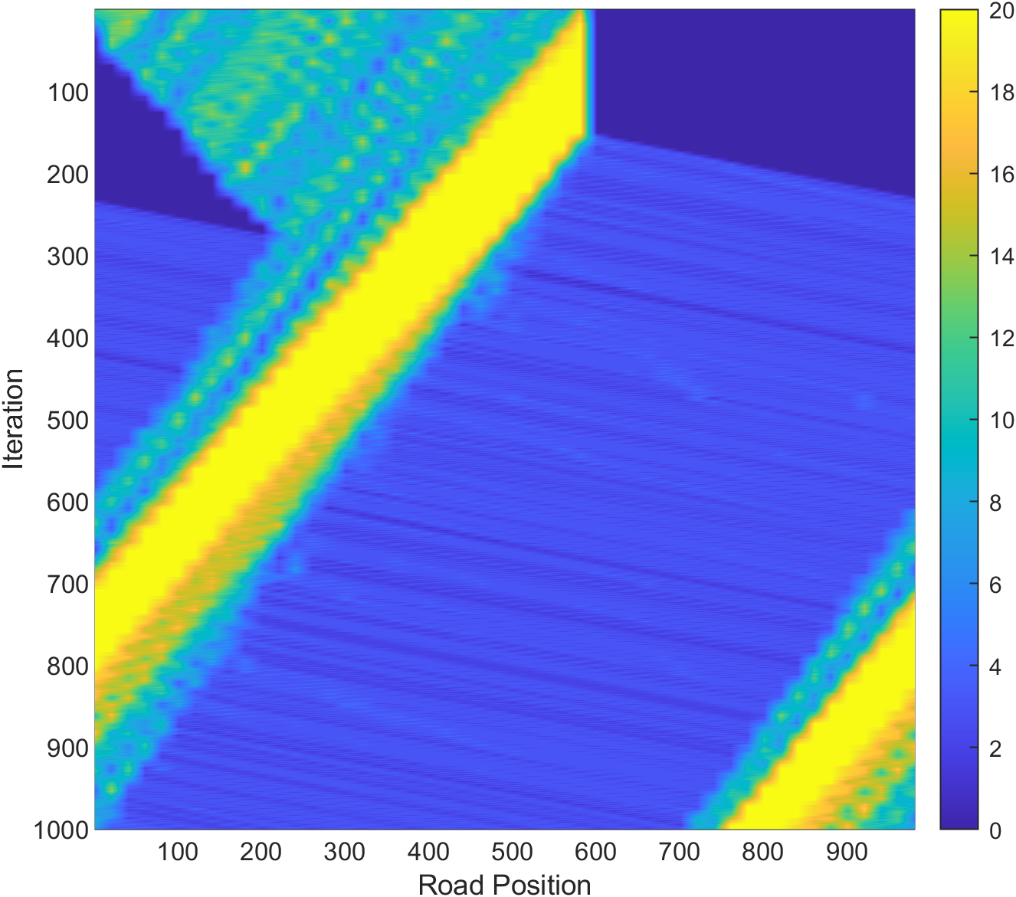
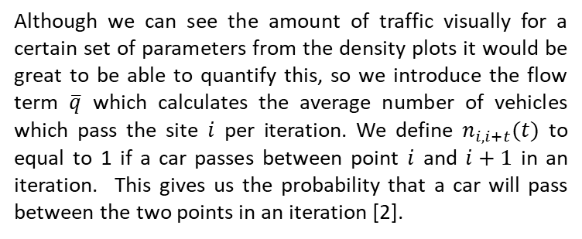
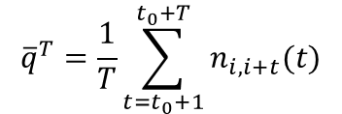
A Cellular Model for Traffic Simulations
Mapping traffic through a closed system
By Sam Walker
One of the most annoying problems which affects everyone in every day life is traffic. From road works to traffic jams, it is not very often that on a journey you are not affected by traffic in some way. The most puzzling by far are once which seam to form without reason, appearing out of nowhere and then suddenly fading into nothing several miles later with no obvious cause. We will explore a 1-dimensional model of the traffic to try and determine when and why these sort of random traffic jams form. Using this model, we will look at the capacity of a 1-D road and how we can optimize the design to maximize its throughput.
Our model is defined on a one-dimensional array of L sites each of which can be occupied by a single car. Each car will then have an integer velocity from 0 to v_{max} which determines the number of cells the car travels in each iteration. For an arbitrary configuration, the following steps are computed in order to determine state of the next iteration [1,2]:
$${\overline{q}}^{T}=\frac{1}{T}\sum_{t=t_{0}+1}^{t_{0}+T}{n_{i,i+t}(t)}$$
Although we can see the amount of traffic visually for a certain set of parameters from the density plots it would be great to be able to quantify this, so we introduce the flow term $\overline{q}$ which calculates the average number of vehicles which pass the site $i$ per iteration. We define $n_{i,i+t}(t)$ to equal to 1 if a car passes between point $i$ and $i+1$ in an iteration. This gives us the probability that a car will pass between the two points in an iteration [2].
Rules for Cellular model
Acceleration: if the velocity v of a vehicle is lower than v_{max} and if the distance of the next car ahead is larger than v+1, the speed is increased by 1
Slowing down: if a vehicle at site i sees the next vehicle at site i+j (with j≤ v), it reduces its speed to j-1
Randomization: with probability p, the velocity of each vehicle is decreased by one.
Car motion : each vehicle is advanced by v sites
We can then plot the flow rate as a function of the density of the plot, We find that for the fixed parameter p=0.1 the maximum flow along the road is 0.678 which occurs at a density of 13.87%. Below this we have too few cars where there is simply too few cars on the road. Above this critical value, traffic sets in and the cars become conjected so the flow rate decreases back to 0 when the road is full and no cars can move.
Car Positions
9.....5..21.6..7.......8..34..
.9......52.1..6.....7....83.4.
4..9....5.2..1...6......78.3..
..4...9..5..2...1....6..7.8.3.
3....4..9..5...2....1..6.7.8..
...3..4...9...5....2..1.6.7..8
..8..3..4....9....5..2.1.6..7.
.7..8..3...4.....9..5.2.1..6..
6..7..8...3....4...9.5.2..1...
..6.7....8....3...4.95...2...1
.1.6.7.......8...3.49.5.....2.
21..6..7........8.349...5.....
2.1...6...7......834.9.....5..
.2..1....6....7..83.4..9.....5
5.2....1....6...783...4...9...
Another diagram which is useful for traffic modelling is that of the average velocity vs the density, by averaging the velocity of all iterations [1]. We see that the average velocity remains fixed at v_{max} until the density reaches the same 13.87% and then decays until the average velocity reaches 0 as we would expect as the all the site on the road are full and no cars can move.
Combining the previous two graphs we can come to the conclusion that up until the critical density the traffic flows freely with very little interactions between the cars. Past this critical point the iterations become frequent enough that they effect the cars velocities and as such the average velocity drops and the flow rate decreases. We call this free and congested flow [1].
For all the graphs shown in the plot we set v_{max} = 5 in order to keep the system realistic and provide the most accurate results. We also set p=0.1 in order to promote the creation of traffic jams in the system while also again keeping the system realistic [3].
We can follow the path of each car through along the road. For simplicity it is easier to form the road into a circle such that the number of cars on the road is fixed. The direct plot is hard to understand but plotting the density of the cars makes It easer to see what is happening. The plot for the paths to the left can be seen at the top of the poster [3].
Through setting v_{max} to be a function of both time and space we can simulate road conditions such as a road closure at the halfway point up to iteration 150. If we reopen the road after 150 back up to normal speed, we see that traffic jam doesn’t immediately clear but instead slowly reduces in size and move backwards from the initial closure. We do also see the formation of smaller traffic jams on the leading and trailing edge where the car densities is higher [1]. Over a longer simulation we would expect to see these edges grow as the cars diverge.
We clearly see the traffic form in the model above with the density of traffic calculated over a rolling average of each time slice and then interpolated to produce a smoother plot. We see the size of each traffic jam, areas of high density, increase and decrease as the number of cars entering and leaving fluctuates. The average point of the traffic jams naturally tends backwards as cars are added to the traffic jam from behind and cars leaving reduce the density, We do see that most traffic jams do decay into nothing over the simulation as the number of cars entering exceeds that entering,
[1] Lárraga, M. E., del Río, J. A., & Alvarez-lcaza, L. (2005). Cellular automata for one-lane traffic flow modeling. Transportation Research Part C: Emerging Technologies, 13(1), 63–74. https://doi.org/10.1016/J.TRC.2004.12.001
[2] Nagel, K., & Schreckenberg, M. (1992). A cellular automaton model for freeway traffic. Journal de Physique I, 2(12). https://doi.org/10.1051/jp1:1992277ï
[3] Sugiyamal, Y., Fukui, M., Kikuchi, M., Hasebe, K., Nakayama, A., Nishinari, K., Tadaki, S. I., & Yukawa, S. (2008). Traffic jams without bottlenecks-experimental evidence for the physical mechanism of the formation of a jam. New Journal of Physics, 10. https://doi.org/10.1088/1367-2630/10/3/033001

